Slide 1

Gruop 8
WEBSITE
DULICHVN
YOUR NEXT ADVENTURE STARTS HERE
www.DulichVN.com

Slide 2

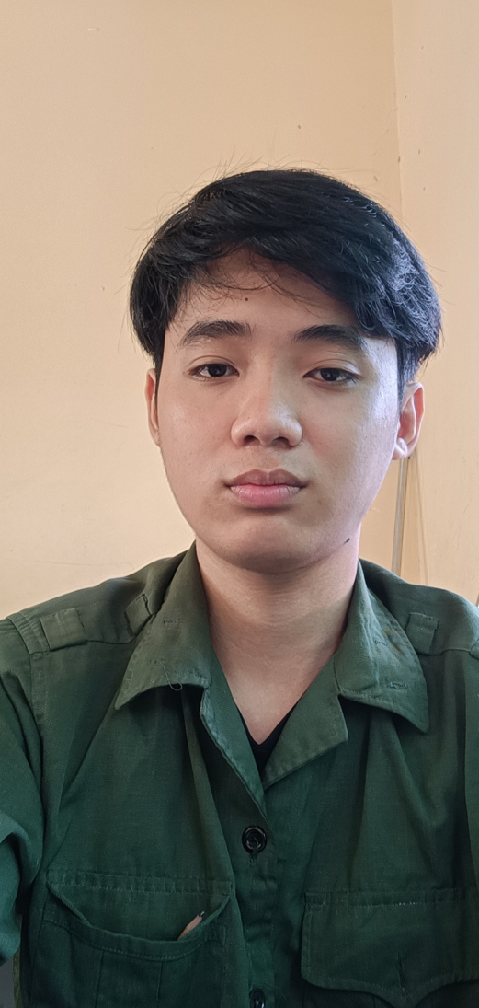



Our Team
Nguyễn Trung Tín
Đoàn Thanh Tùng
Nguyễn Thanh Tùng
Nguyễn Trọng Vũ
BS00491
BS00508
BS00541
BS00497

Slide 3

Introduction to the topic
The goal is to provide complete, easy-to-use travel information. The scope of the study includes famous tourist destinations. The meaning is to contribute to the development of Vietnam's tourism industry.

Slide 4
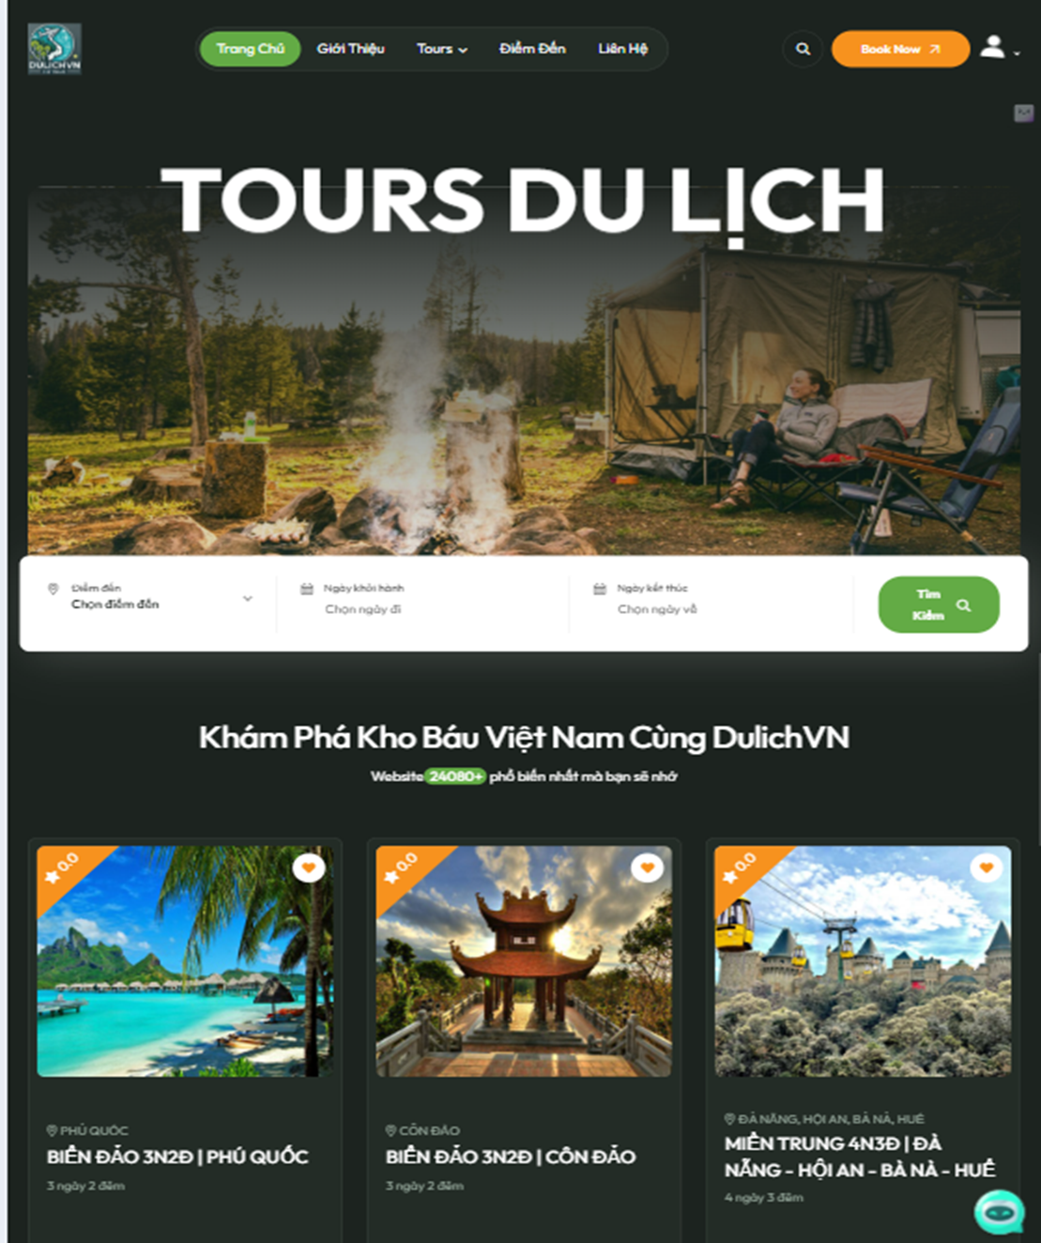
Overview: Analysis Of Vietnam Tourism Websites
Introduce the current landscape of Vietnam tourism websites. Highlight opportunities for improvement and innovation. Establish a foundation for proposed solutions.

Slide 5

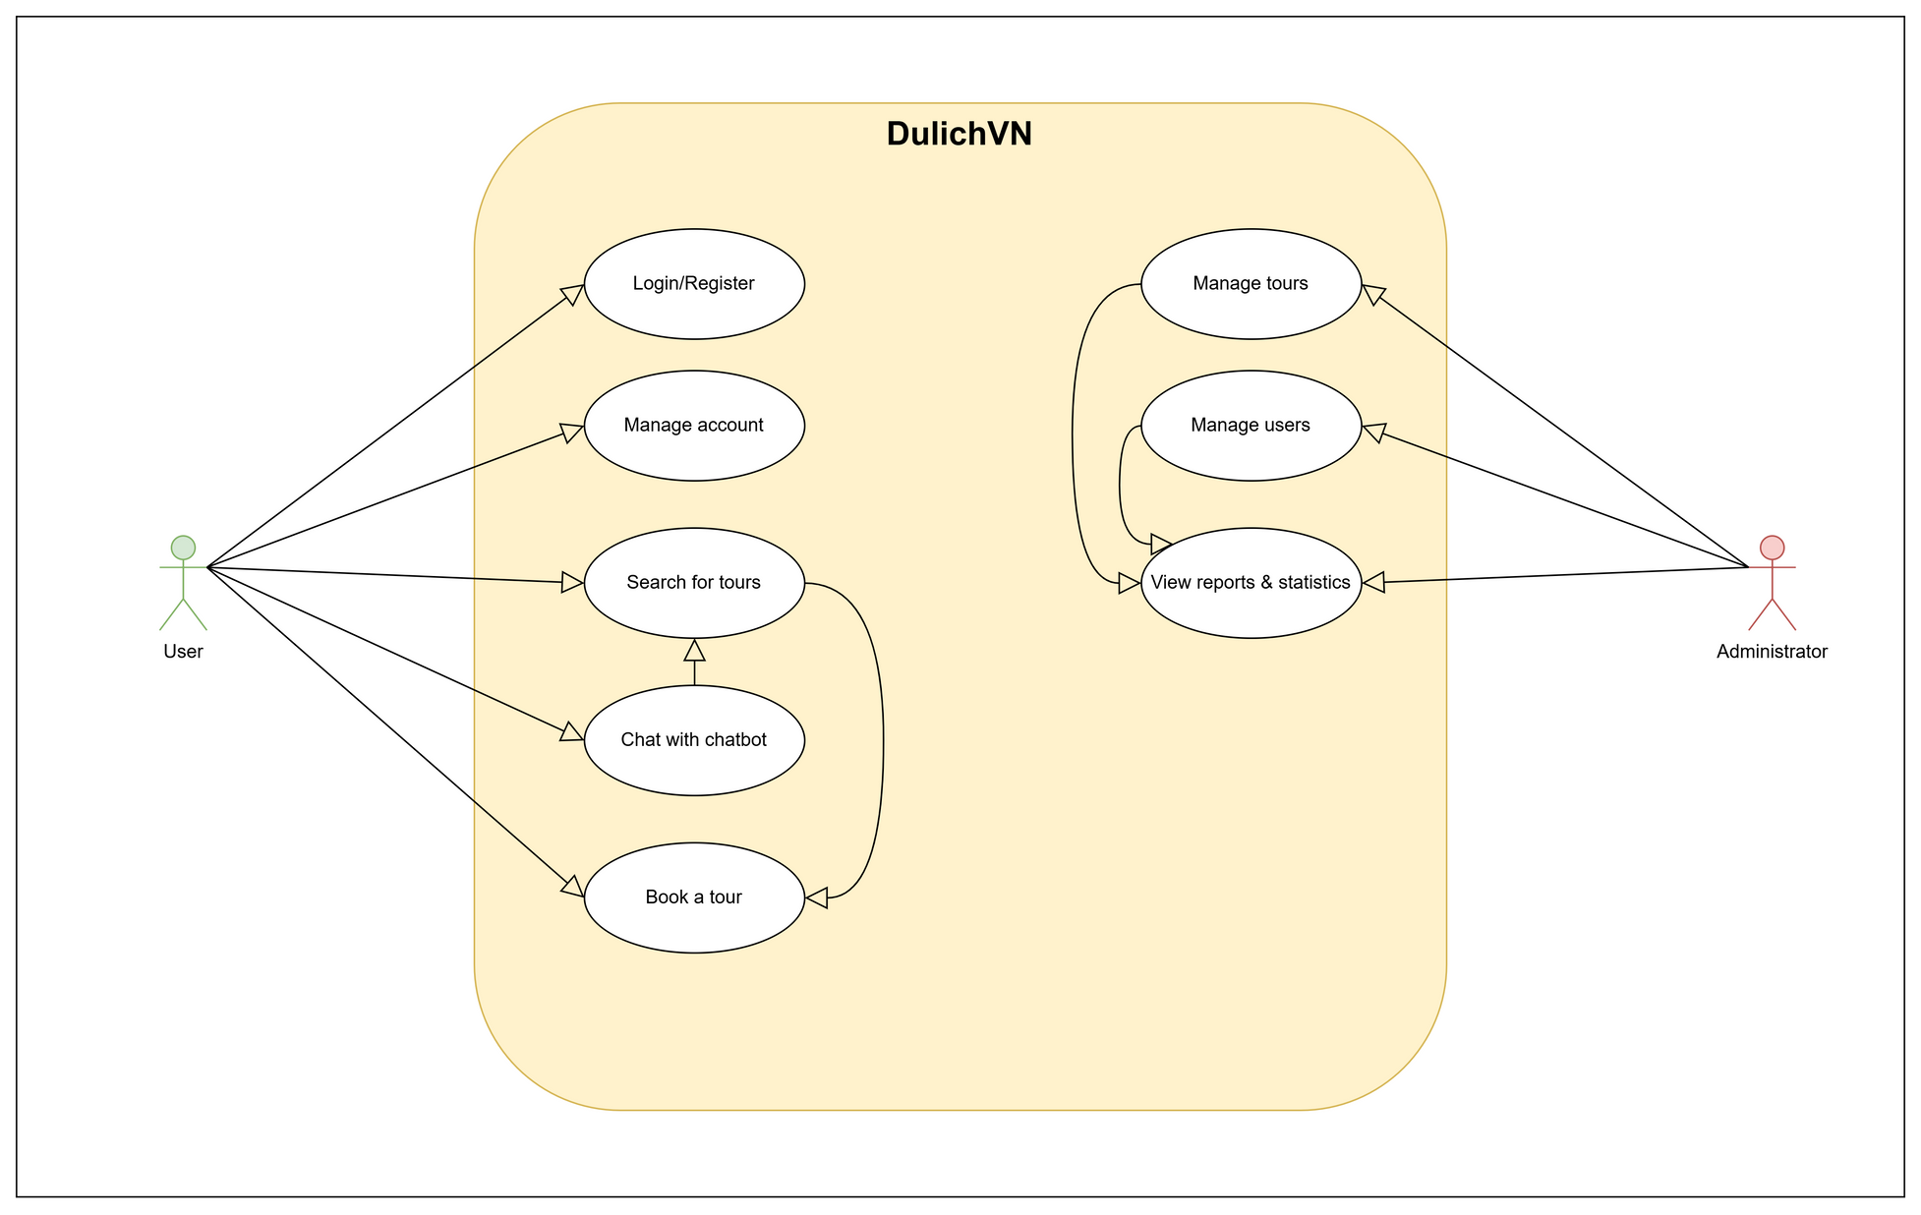
Use Case Diagram

Slide 6
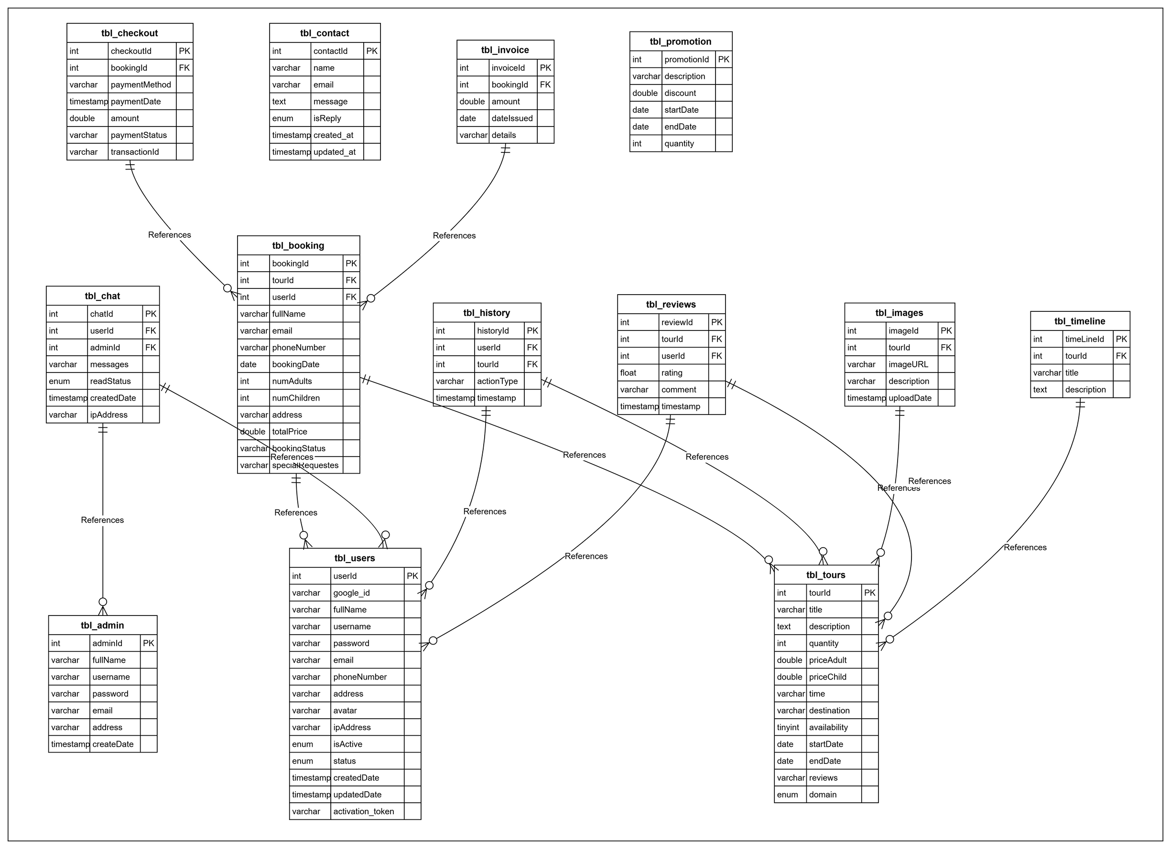
ERD Diagram

Slide 7
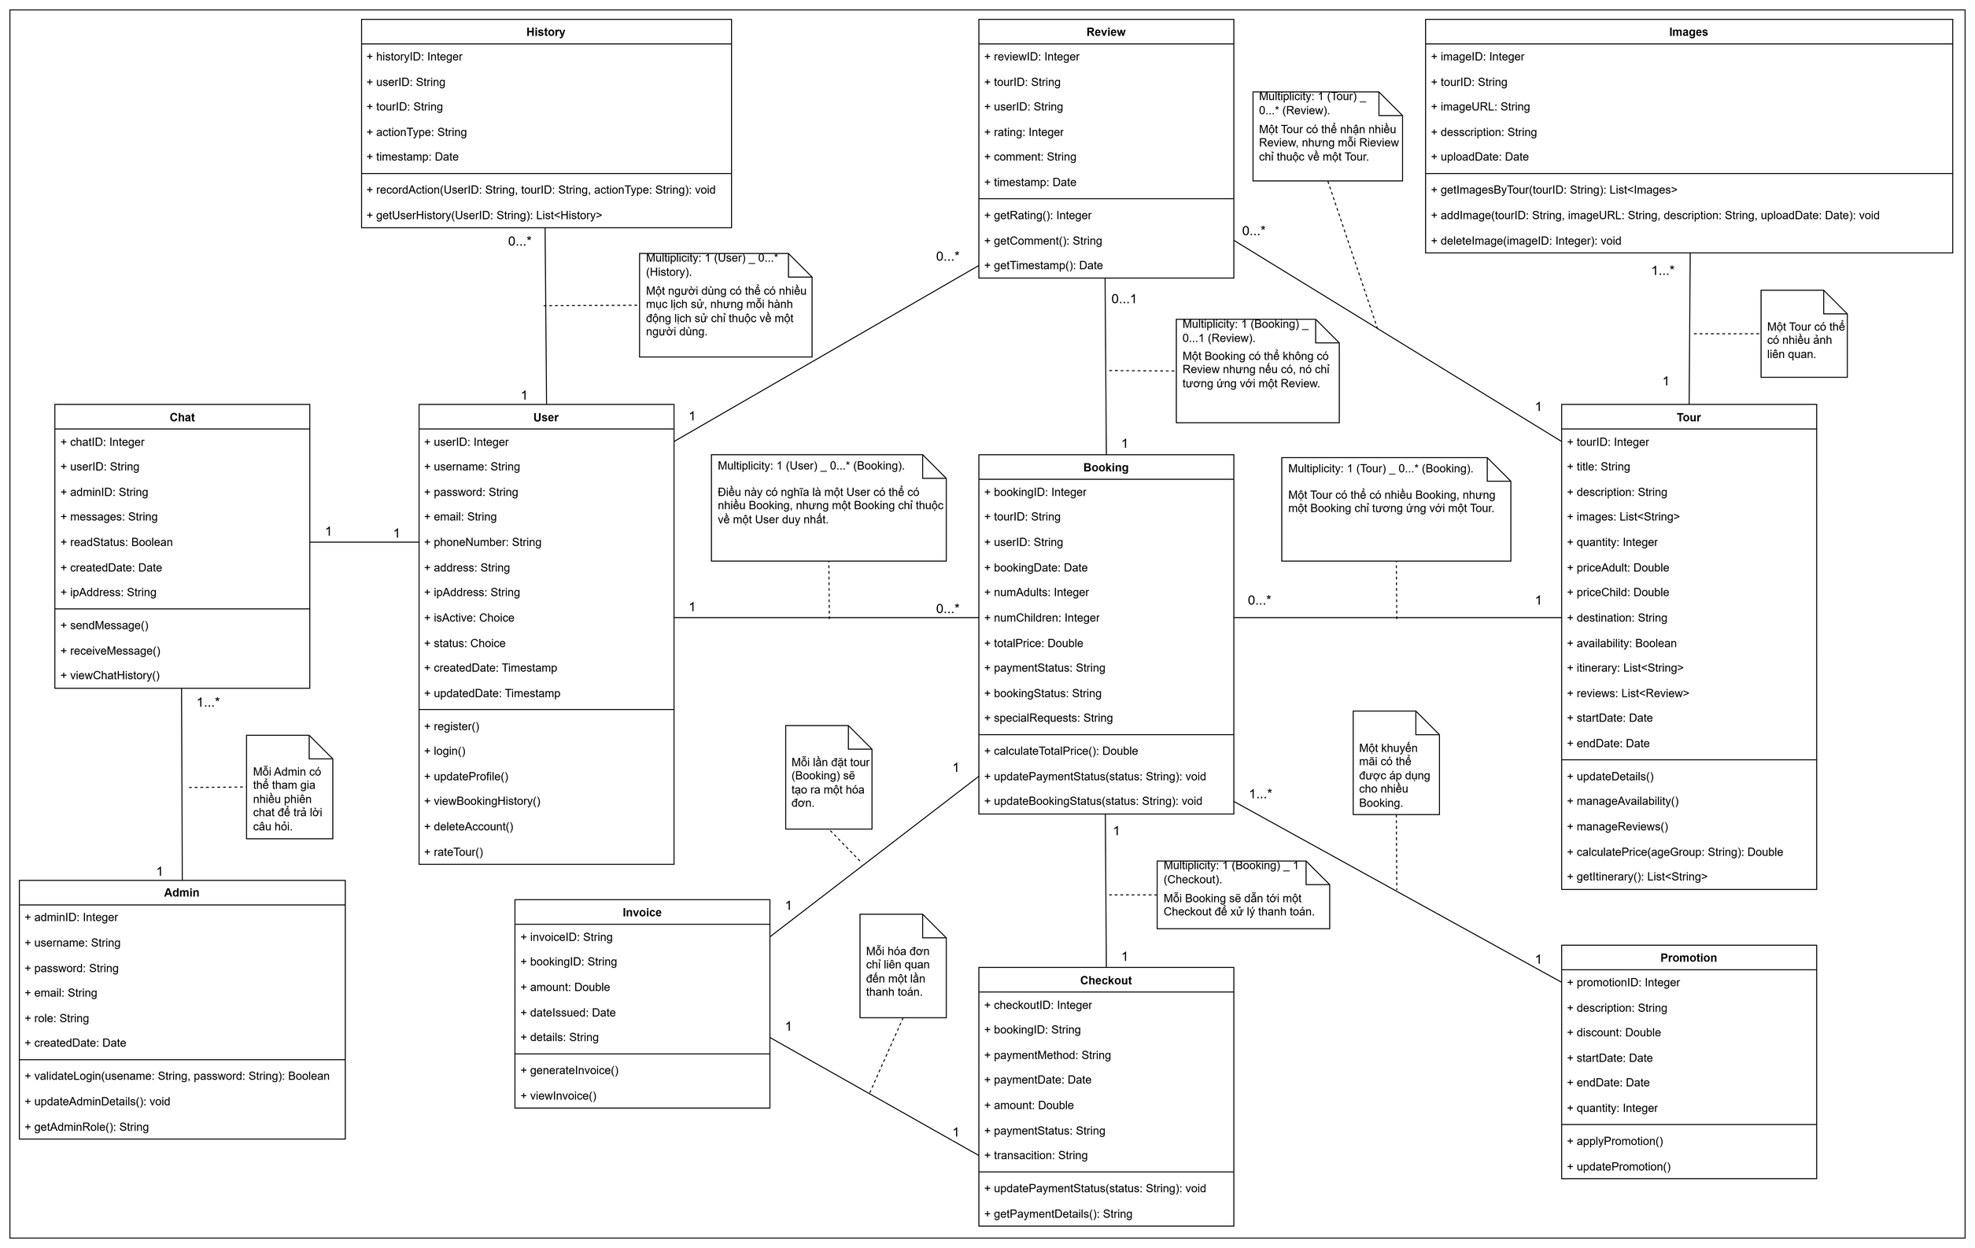
Class Diagram

Slide 8

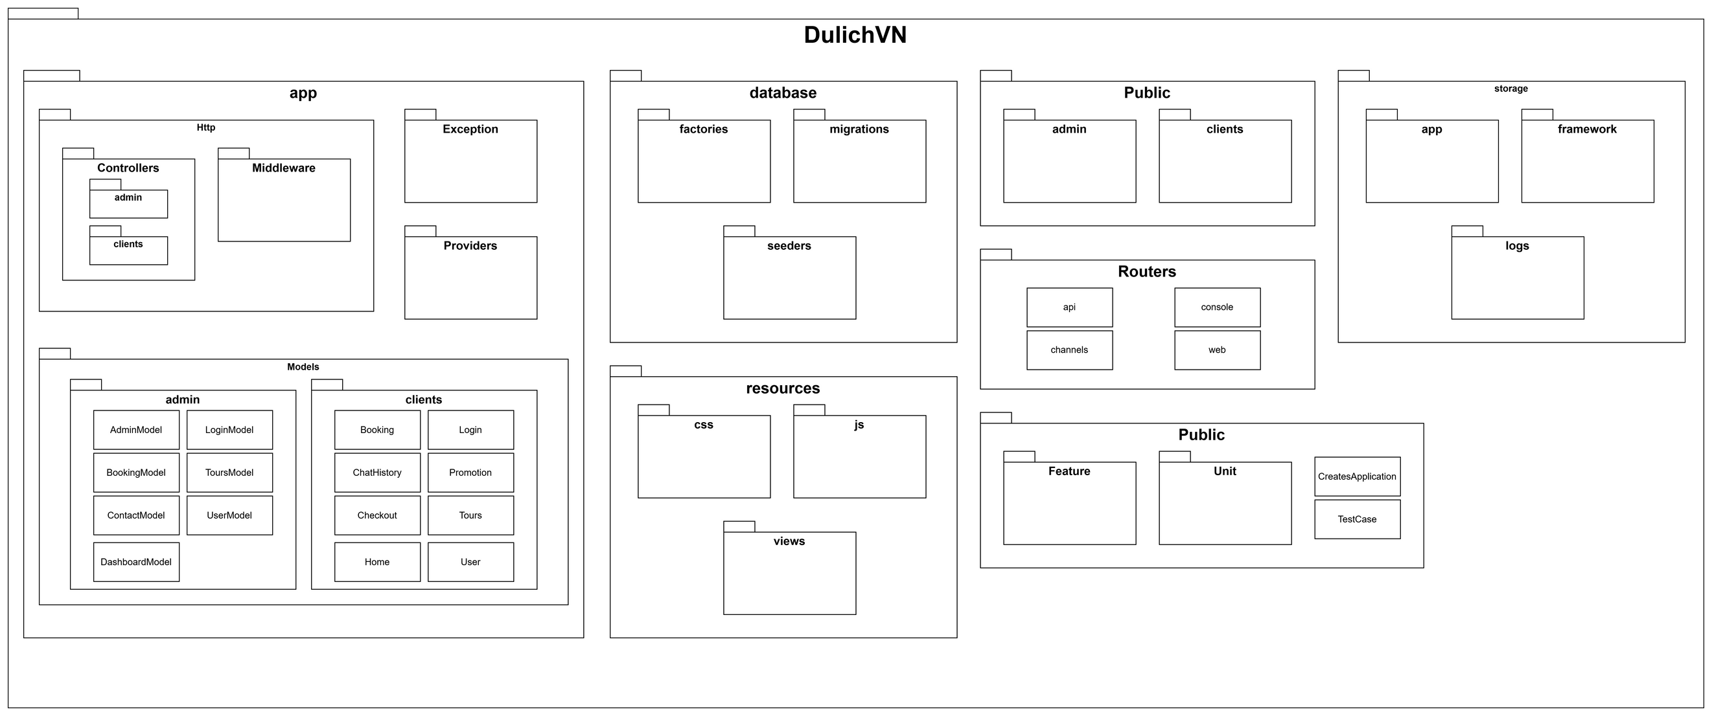
Package Diagram

Slide 9


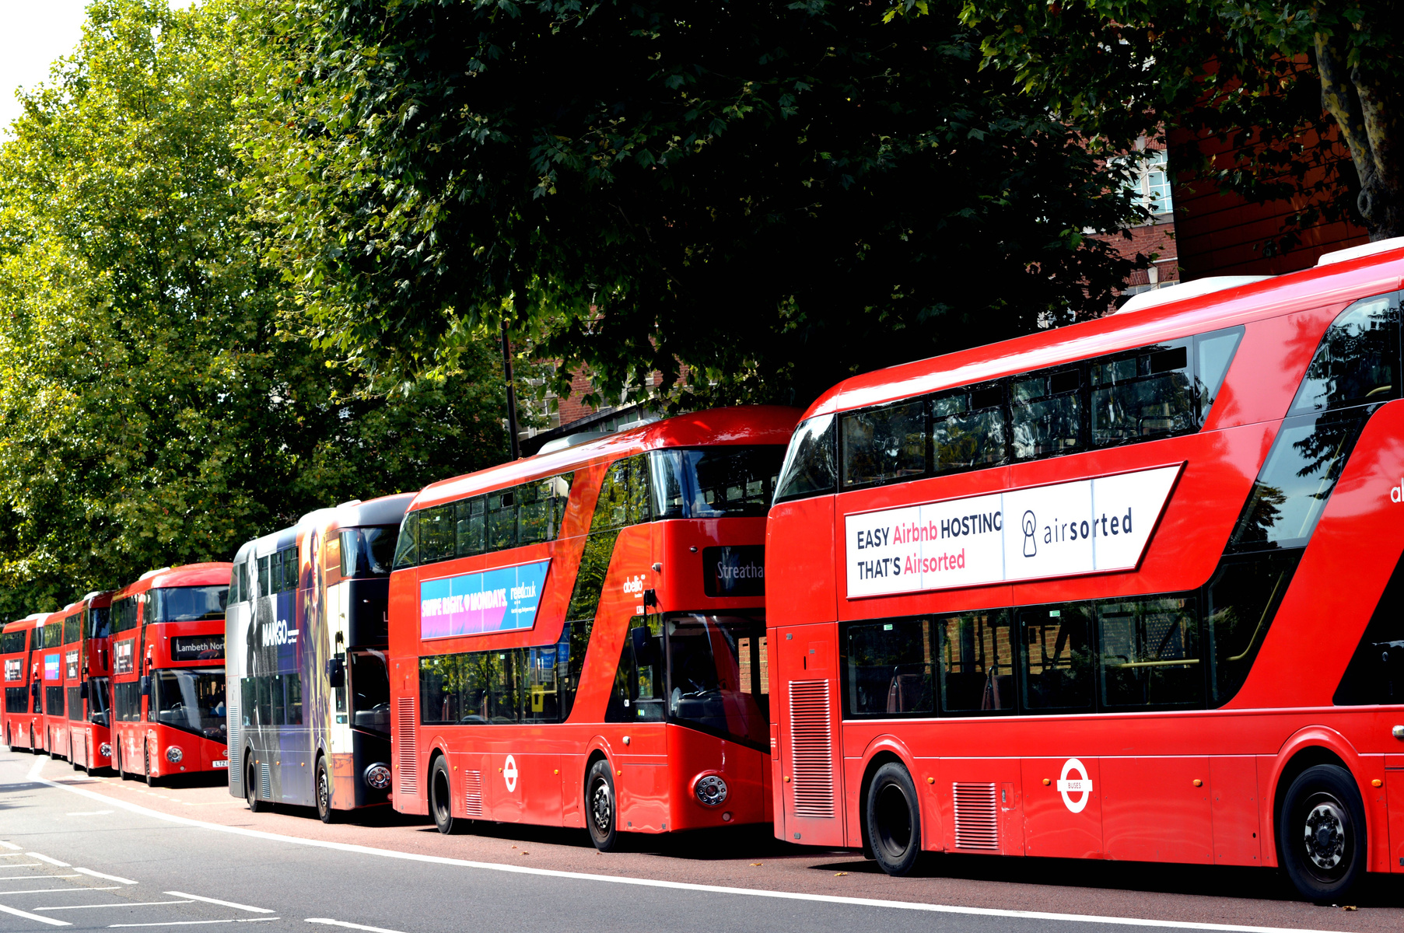



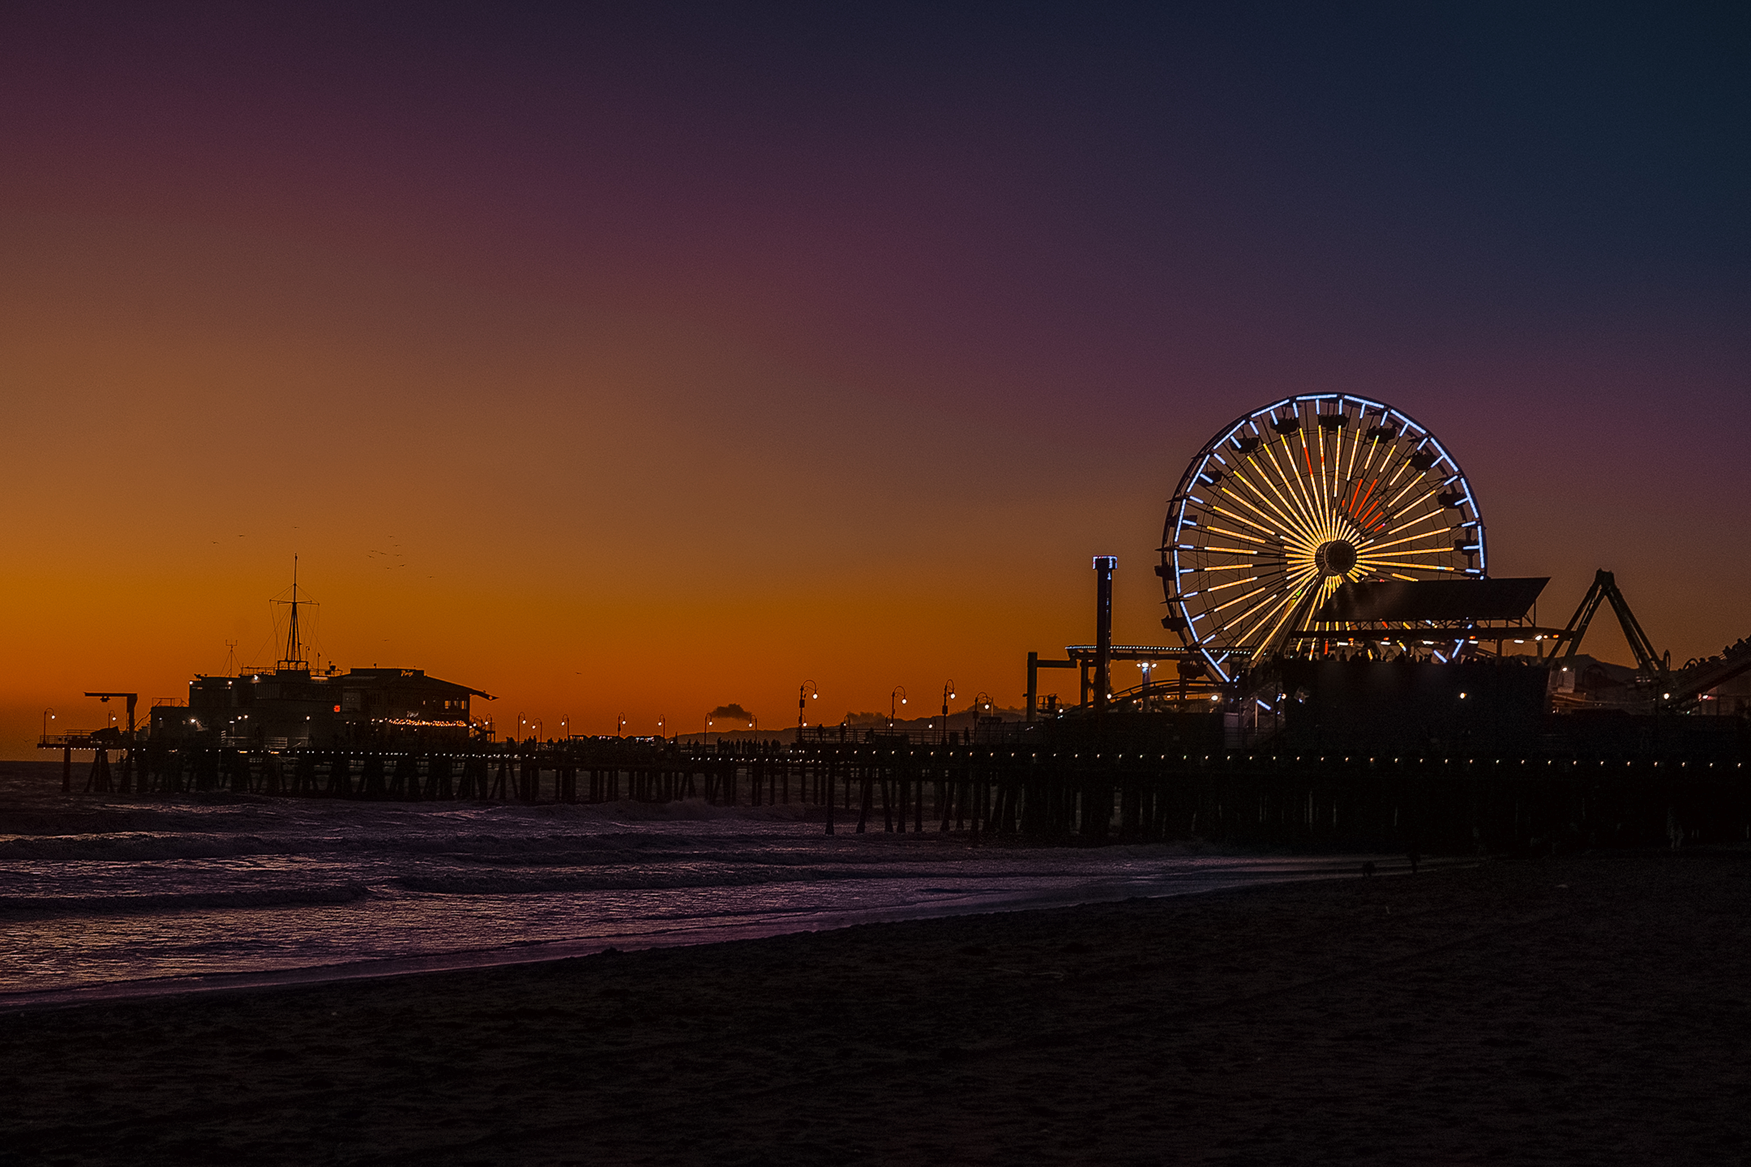
Our Services
Tour Guide
Administration
Transport
Hotel Reservation
Meals
Ticketing

Slide 10






Key Features
Search for tourist attractions
Book a tour
Search for tourist attractions by category or area
Book tour online
Reviews & Comments
News Blog
Reviews and comments from visitors
Providing news blogs and travel guides
User Management
Chatbot
Manage admin, business and user accounts
Customer care support

Slide 11










Technology used
Frontend
• HTML, CSS (Tailwind), JavaScript, React
Backend
• Node.js + Express or PHP + Laravel
Other Tools
• jQuery for interactive components, Blade templates for dynamic content display
• Gemini 1.5 Pro integration for chatbot support and AI support

Slide 12




AI Chatbot Integration
Travel destination consulting
Quick FAQ
Reduce the load on customer service department
Support users to search and suggest tourist destinations that suit their interests. For example: nature, culture, cuisine.
Provide quick information about time, tour price, vehicle, schedule.
Chatbots handle simple requests. Free up customer service agents to focus on more complex issues.
Package 1

Slide 13
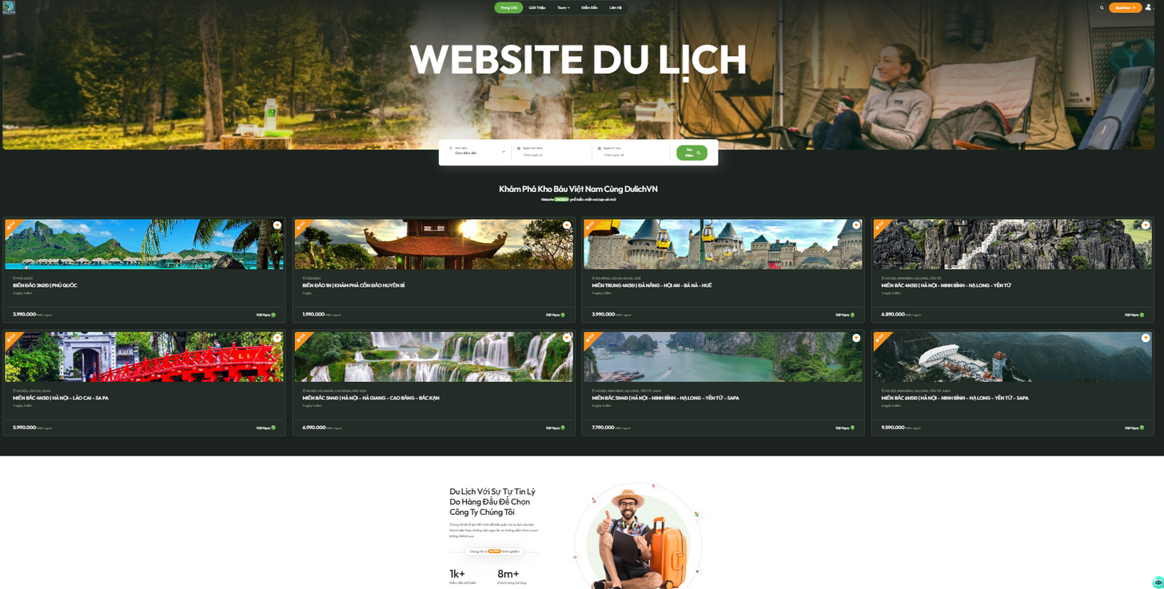
Demo Website
HOME PAGE REVIEWS

Slide 14


References
Link video:
https://www.youtube.com/watch?v=9G0jkR5LkS8&list=PLIro1GlPm0pwxLogBo0uvuYPdKDWHVMRW
Link github:
https://github.com/dienakdz/travela

Slide 15





Q & Q

